Slide 1
Acts
1:6-8 ⁶So when they met together, they asked him, “Lord, are you at this time going to restore the kingdom to Israel?”
⁷He said to them: “It is not for you to know the times or dates the Father has set by his own authority. ⁸But you will receive power when the Holy Spirit comes on you; and you will be my witnesses in Jerusalem, and in all Judea and Samaria, and to the ends of the earth.”

Slide 2
Acts
9:32 As Peter travelled about the country, he went to visit the saints in Lydda
9:35 All those who lived in Lydda and Sharon saw him and turned to the Lord.
9:42-43 This became known all over Joppa, and many people believed in the Lord. ⁴³Peter stayed in Joppa for some time with a tanner named Simon.

Slide 3
Acts
12:24 But the word of God continued to
increase and spread.

Slide 4
The Early Church Matures
Mission and Growth
June 12th - Tony Lyon

Slide 5
Mission and Growth
Peter expands the ministry beyond Jerusalem/Acts 9:32-43
Jesus’ mandate
So when the apostles were with Jesus, they kept asking him, “Lord, has the time come for you to free Israel and restore our kingdom?”
⁷ He replied, “The Father alone has the authority to set those dates and times, and they are not for you to know. ⁸ But you will receive power when the Holy Spirit comes upon you.
And you will be my witnesses, telling people about me everywhere—in Jerusalem, throughout Judea, in Samaria, and to the ends of the earth.”

Slide 6
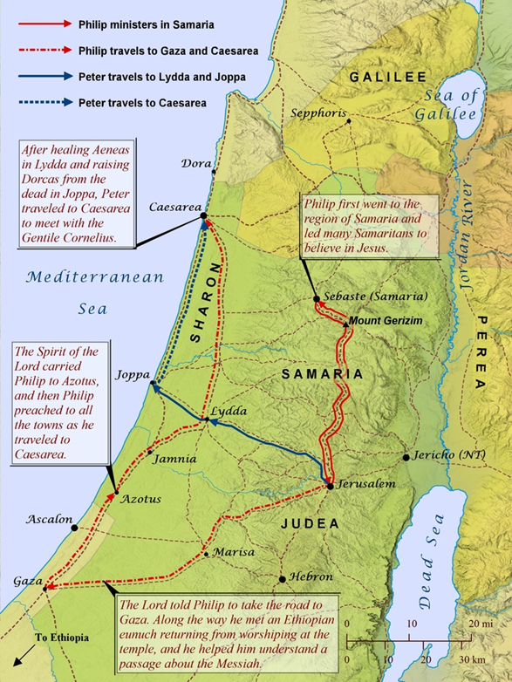
Mission and Growth
Peter expands the ministry beyond Jerusalem/Acts 9:32-43
³³ Meanwhile, Peter traveled from place to place, and he came down to visit the believers in the town of Lydda. ³³ There he met a man named Aeneas, who had been paralyzed and bedridden for eight years.
³⁴ Peter said to him, “Aeneas, Jesus Christ heals you! Get up, and roll up your sleeping mat!” And he was healed instantly.
³⁵ Then the whole population of Lydda and Sharon saw Aeneas walking around, and they turned to the Lord.

Slide 7
Mission and Growth
Peter expands the ministry beyond Jerusalem/Acts 9:32-43
Notice how strategic Peter was
Lydda - was located twenty-five miles northwest of Jerusalem, at the crucial intersection of the highways from Egypt to Syria and from coastal Joppa to Jerusalem.

Slide 8
Mission and Growth
Peter expands the ministry beyond Jerusalem/Acts 9:32-43
Summary
Peter has journeyed from Jerusalem {His comfort zone}
Travelling going from place to place
He visits the believers in the town of Lydda
Meets a man named Aeneas ***
Aeneas has been paralised and bedridden for 8 years
Aeneas is healed
The people see him walking around ***
They turned to the Lord

Slide 9
Mission and Growth
Peter expands the ministry beyond Jerusalem/Acts 9:32-43
We now come to the second miracle, at Joppa
Joppa - (modern Jaffa) was the ancient seaport for Jerusalem. Situated on the coast thirty-five miles northwest of the capital city and ten miles beyond Lydda, it possesses the only natural harbor on the Mediterranean between Egypt and Ptolemais.
Another strategic location

Slide 10
Mission and Growth
Peter expands the ministry beyond Jerusalem/Acts 9:32-43
A believer named Tabitha becomes ill and dies
Tabitha is kind and always helping others, particularly the destitute widows
Tabitha was a seamstress and made coats and clothes
The believers hear that Peter is at Lydda and send two men to implore Peter to come. What for it does not say!
Peter returns with the men and is ushered into the room where she lay washed but not anointed for burial

Slide 11
Mission and Growth
Peter expands the ministry beyond Jerusalem/Acts 9:32-43
Peter asks everyone to leave the room
Kneels and prays
Get up, Tabitha says Peter
Tabitha opens her eyes
He helps her up
He calls in the widows and believers
The news spread through the town
Many believed in the Lord

Slide 12
Mission and Growth
Peter expands the ministry beyond Jerusalem/Acts 9:32-43
Peter stayed a long time in Joppa living with Simon the Tanner
Tanners dealt with carcasses and thus with strong odors; they normally had to reside outside the walls of the city. Conservative Jewish pietists would limit involvement with them, since those in contact with carcasses were ritually impure. Like Gentiles, however, Jews were more often concerned with the odors. Later rabbis even ruled that tanners’ wives should be permitted to divorce them because of the odors associated with tanning.
Was God preparing Peter for his encounter with the angel and Cornelius? [Acts 10]

Slide 13
Mission and Growth
Peter expands the ministry beyond Jerusalem/Acts 9:32-43
Luke will turn his attention to Christian mission to the Gentile world,(Acts 13 forward) but before he does, he takes the opportunity of presenting two further glimpses of God's working on behalf of the believers at Jerusalem
Luke wants to make the point that, though he is about to portray the advances of the Gospel within the Gentile world, He is not finished with the church in Jerusalem
https://www.biblegateway.com/passage/?search=Acts+12%3A1-24&version=NLT

Slide 14
Mission and Growth
Meanwhile in Jerusalem
Acts 12:1-24
King Herod Agrippa’s persecution of some believers in the church.
Grandson of Herod the Great and nephew of Herod Antipas, he was appointed King over Judea by Emperor Claudius
Has the apostle James (John’s brother) killed
He likes how it pleased the Jewish people, he also arrested Peter. (This took place during the Passover celebration.)
Puts him in prison, Herod intended to bring Peter out for public trial after the Passover.

Slide 15
Mission and Growth
Meanwhile in Jerusalem
Acts 12:1-24
5 But while Peter was in prison, the church prayed.
The church’s response was to pray earnestly and for the duration of Peter’s imprisonment.
Luke skillfully contrasts the power of the state—so Peter was kept in prison—and the power of the church, prayer!
Prayer is the only weapon it has, but it is more than enough.

Slide 16
Mission and Growth
Meanwhile in Jerusalem
Acts 12:1-24
Luke records an amusing narrative to Peter’s release from prison.
The prayer meeting is at Mary’s house (mother of John Mark)
Many people were gathered there
Peter is knocking
Rhoda rushed to the door but fails to open it
The people praying refuse to believe it is Peter at the door even though Rhoda says she heard Peter’s voice

Slide 17
Mission and Growth
Meanwhile in Jerusalem
Acts 12:1-24
They tell Rhoda she is out of her mind!!!
They then decide it must be an angel
Rhoda persists
Finally, they opened the door
They are amazed
Peter motions them to be silent and tells his story

Slide 18
Mission and Growth
Meanwhile in Jerusalem
Acts 12:1-24
What does all these stories tell us? Some of them are:-
Miracles are God’s means of confirming his word
We need to be strategic if we want the gospel to be effective
News of God at work will spread and draw people in
Tyrants get their comeuppance – God takes care of them
God answers fervent prayer
Young people are not always listened too
We at times must leave our comfort zone in order to share the gospel

Slide 19
Mission and Growth
Meanwhile in Jerusalem
Acts 12:1-24
Prayer should be our first resort to deal with a crisis
if it is not, it reveals we are depending on something or someone other than God
We should be greatly comforted that God answers such faithless prayers.
We all tend to be unbelieving believers at times!

